Slide 1
Immunity Insiders
Nutritional Wisdom for your Immune system

Slide 2
Who are we?

Slide 3
What will we cover?
Introduction to how our immune system works
What a nutrition myth is and how to spot one
Discussion of some key nutrients related to immunity
Notes:
- want it to be interactive so please ask questions as we go!

Slide 4
Quiz
Quiz 1: https://forms.office.com/Pages/ResponsePage.aspx?id=bj6EGEYYbEWgXFAPCu4S9oQurVUkuFJFqmcutGWgZ0dURVRKSkM5MUlYTlZEVEtJVDExN0o3NUdMQi4u

Slide 5
The Immune System
Our immune system is an essential part of preventing toxins and other substances causing harm to your body.
The COVID-19 pandemic has made everyone more aware of their immunity – but there is lots of misinformation!
Can we really "boost" our immune system??
Notes:
- - Our immune system is an essential part of preventing toxins and other substances causing harm to your body.
It has become a big talking point for many individuals over the past year looking to “boost” their immunity, since the global pandemic. With an increase in public interest and more misdirection in information given from the internet and news headlines. It has become important to find some clear substance within the noise. In this presentation we look to explore if ‘boosting’ your immunity is even a possibility, and if you can is it safe to do so? We will be separating the fact from the fiction and giving you actionable information to support your immunity
- if you are on any medications or have any underlyting health conditions, consult with your doctor before commencing any supplements or dietary changes

Slide 6
How to spot a nutrition myth
Pressure to buy something
Sounds too good to be true
Demonising certain foods
Who is sharing the information?
Are they suggesting you need to buy a specific product or item?
Are they promising miracle effects?
Are they suggesting a food is “bad” and should always be avoided?
Is it coming from a trustworthy source?
Notes:
How to spot a nutrition myth
• A nutrition “myth” is a statement about a particular food or type of foods that is not backed up by research
• “Dietitian” is a registered term, “Nutritionist” is not, meaning anyone can claim to be a “nutritionist”
• Focus on a specific nutrient
• Unrealistic claims / sounds too good to be true
• Pressure to buy something
• Demonising certain foods or suggesting Severe restrictions
Evidence-based resources:
• British Nutrition Foundation
• British Dietetic Association “Food Facts”
• Change 4 life resources
• NHS Choices Live Well online resources

Slide 7
Can you “boost” your immune system?
The right amount of vitamins helps our immune system work as it should
Malnutrition is the most common cause of immune deficiencies worldwide
Taking more vitamins than you need won't make your immune system work better
An over-active immune system can lead to allergies and auto-immune diseases
Notes:
- your immune system is like a gard
- vaccines
- sometimes things go wrong in our immune system, such as allergires, autoimuune diseases or failure to catch germs. These things are very complex, not fully udnerstood and wont be fixed by one single immune boosting pill.

Slide 8


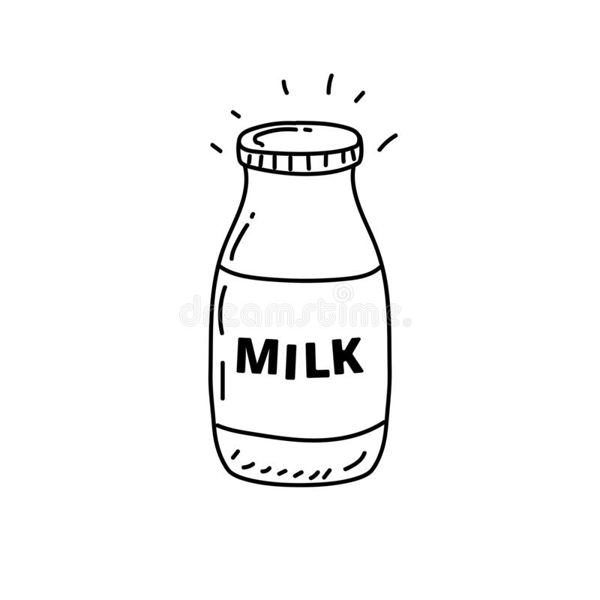

“Dingbats” Picture Game

Slide 9
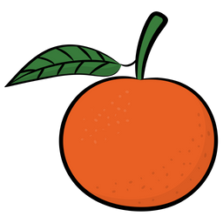


“Dingbats” Picture Game

Slide 10

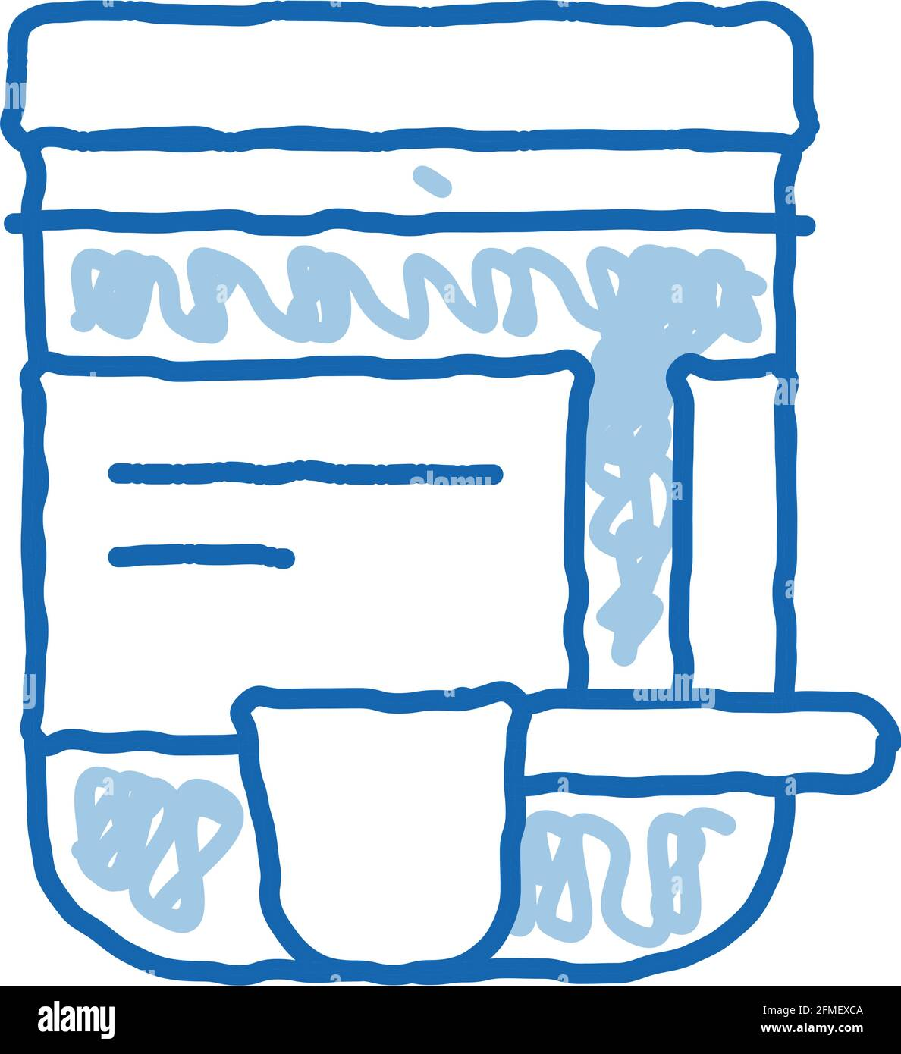
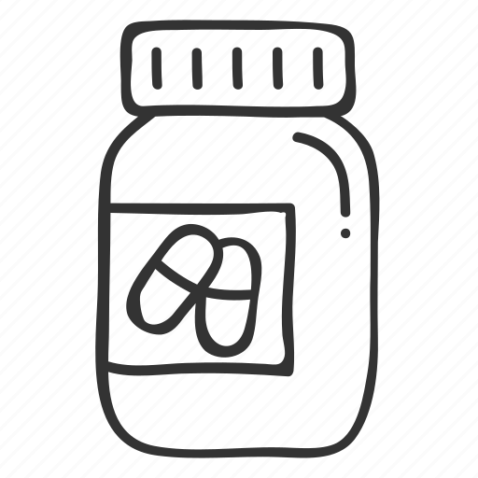
“Dingbats” Picture Game
- MINT

Slide 11
Vitamin D
Myth
Fact
Action
Research shows vitamin D does not help to treat COVID-19
But it is important for our bones
Vitamin D is made when the sun shines on our skin
10 microgram vitamin D supplement recommended in winter
“Vitamin D cures
COVID-19”
Notes:
- there is currently jo good evidence that any "immune boosters" or other supplements can prevent treat cure COVID-19 or other viral infections

Slide 12
Myth
Fact
What can I do?
Vitamin C
“More
Vitamin C gives you
more
immunity”
Excess
Vitamin C is removed in your urine
40 mg a day
Good sources: citrus fruits, peppers, broccoli

Slide 13
Vitamin D is important for bone health
Excess vitamin C is removed in your urine
Vitamin D can cure COVID-19
Two Truths and a Lie

Slide 14
Taking multivitamins will “boost” our immune system
Vitamin C helps our immune system to work properly
Oranges are a good source of vitamin C
Two Truths and a Lie

Slide 15
What can I do?
Myth
Fact
Supplements
"Supplements can replace a healthy diet"
Most people get all the nutrients they need from a healthy balanced diet
A healthy balanced diet with a variety of fruits, vegetables and protein sources is key!

Slide 16
The “Three Things” Game

Slide 17
What are the main take aways?
Be mindful over which information is truthful. Is it too good to be true?
Only use supplements if advised by a medical team.
Vitamin D supplements are advised by medical professionals during the winter months due to lack of daytime hours.
Having a healthy balanced diet, with a variety of fruit and veg and protein sources is the best way to incorporate your daily nutrients and minerals intake.
Obtaining your daily nutrients and minerals intake helps to support your immunity and general health.
Notes:
- if you are on any medications or have any underlyting health conditions, consult with your doctor before commencing any supplements or dietary changes

Slide 18
Quiz
Quiz 2:
https://forms.office.com/Pages/ResponsePage.aspx?id=bj6EGEYYbEWgXFAPCu4S9oQurVUkuFJFqmcutGWgZ0dUQzZUNEdZQ08yU1VQWldIVTNTMDRCVExNUC4u

Slide 19
Thank you for coming to our stall

